Slide 1
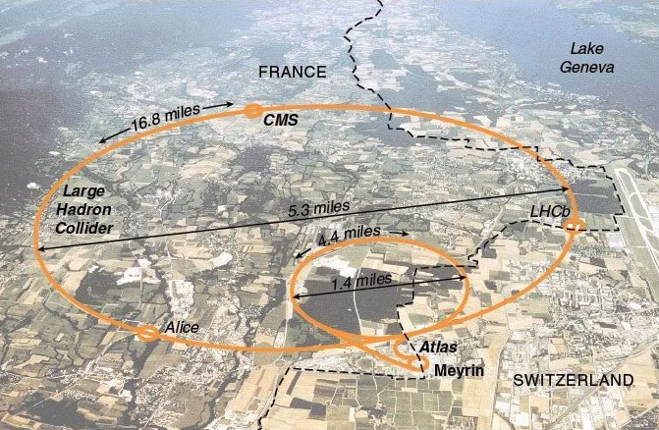
CERN-CONNECT

Slide 2
How do you discover events at CERN?
How do you know who’ll be there?

Slide 3
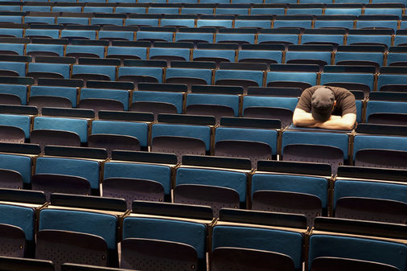
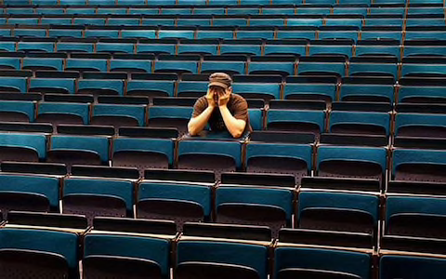
What if ….
you are alone in the lecture?

Slide 4

Notes:
And you find out.. Your friends are in a festival..

Slide 5
The problem...
Events coordination
Events engagement
Events discovery
Misunderstandings
Organization overhead
No live interaction
Little participation
Lack of excitement
Lack of attendance
Difficult to know about other groups
Indico plain interface

Slide 6
We help you escape the mess!
But how?

Slide 7
Solution
Live CERN map which allows people to check any event participation.
From their location, to the position of the participants before their start.
CERN - CONNECT

Slide 8
Demo

Slide 10
How did we do it?

Slide 11
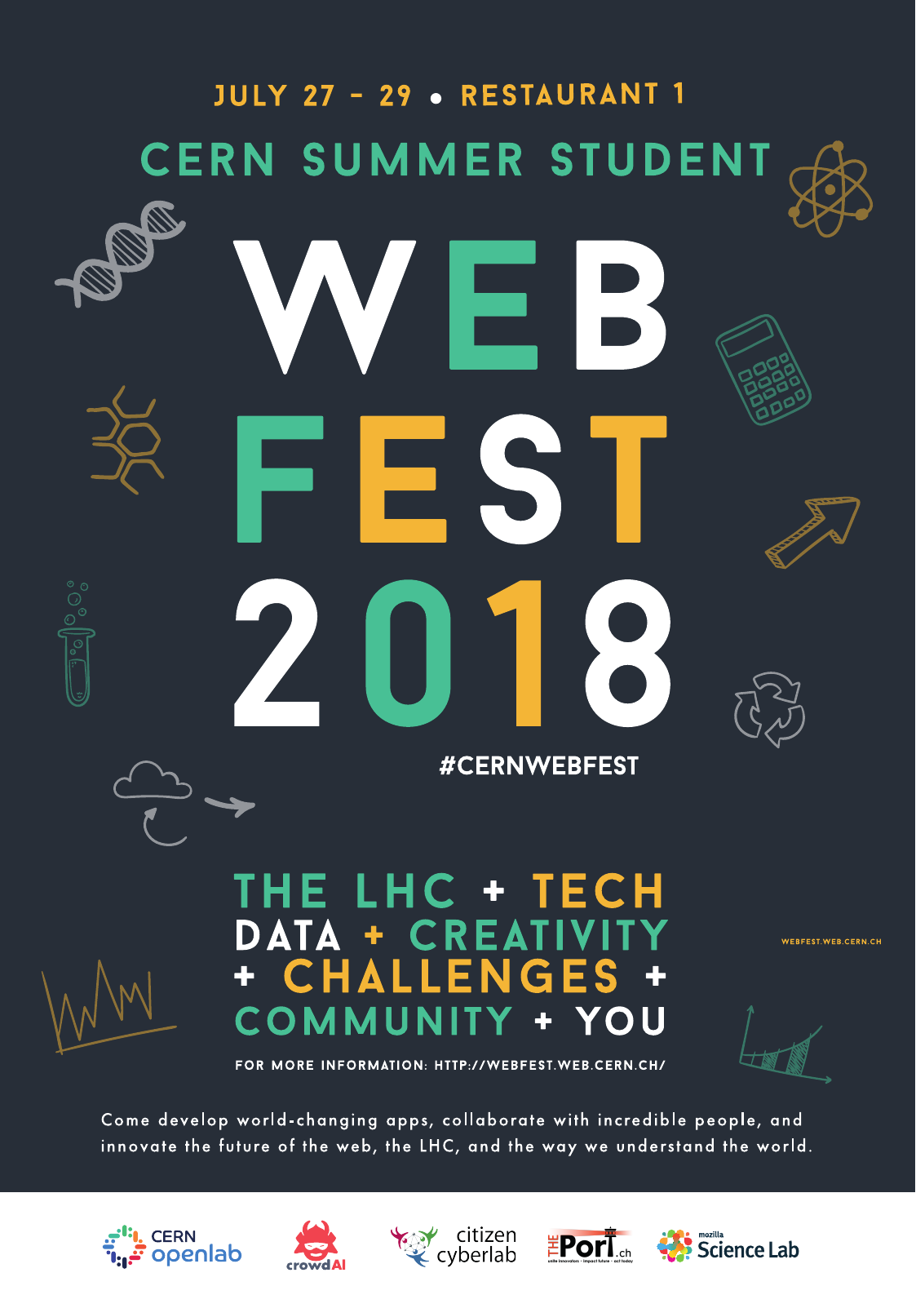
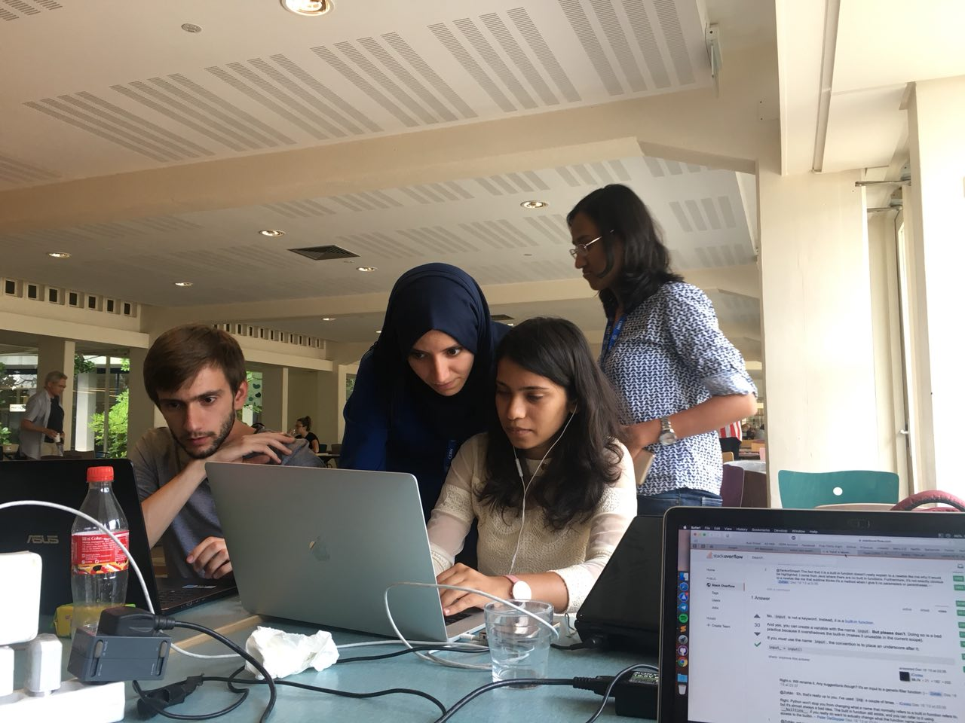

Slide 12

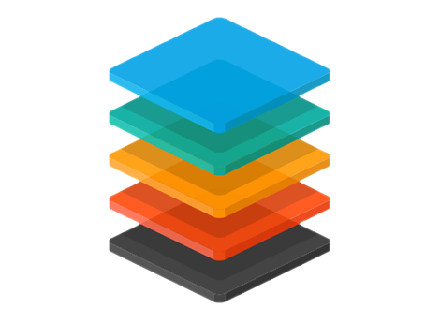

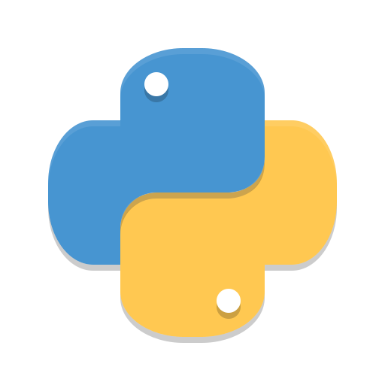
Technology Stack...
JAVASCRIPT
Leaflet
Semantic UI
PYTHON 3
Flask
Notes:
Add tech- stack

Slide 13
Platform-wide application
CERN authentication
Emergency alerts
Future Scope
Syncing Indico / FB events
Section/Group filtration
Notes:
Change blue to white color if possible… ;)
Integration with indico account. Integration with fb
Mobile apps for background refresh

Slide 14
Impact
Helping people Connect

Slide 15
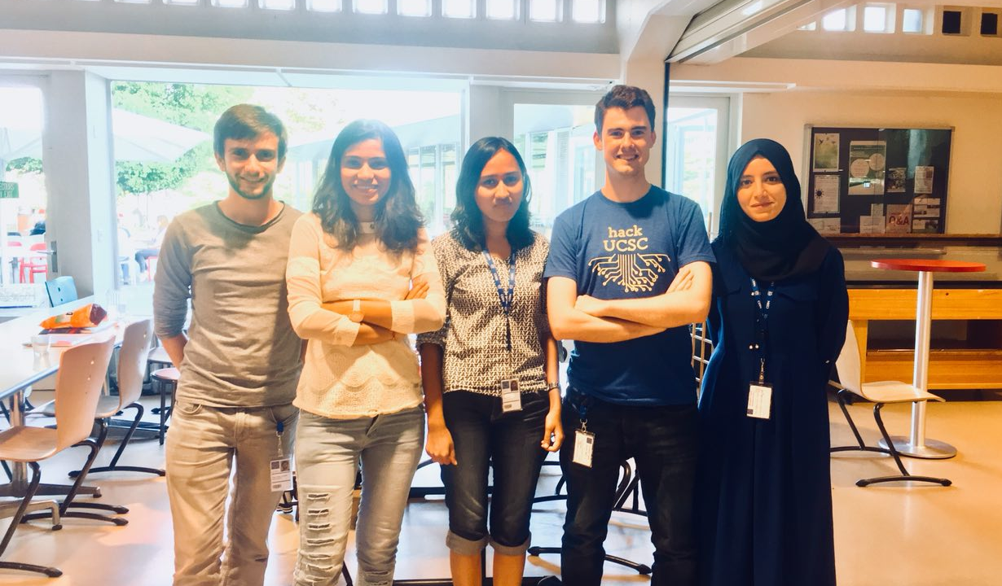
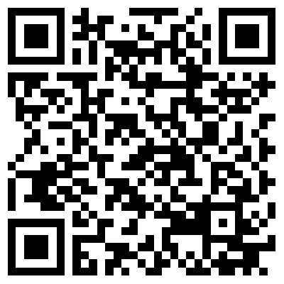
Thank you! We’re here for your questions. :)

